Slide 1
Welcome Meeting
2026-2027

Slide 2
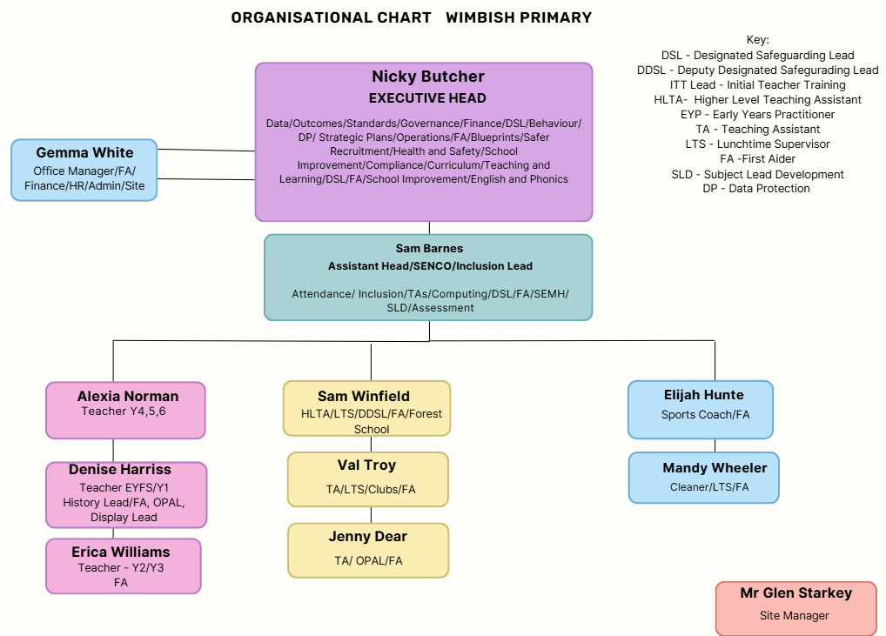

Slide 3
The Plan
-Meet the teacher and visit the classrooms
-5:15pm: Whistle will blow, adults to return to hall and children to go to their classroom. Any pre-school children can either stay in hall or listen to the story.
SLT Presentation on:
-Priorities for this academic year at WPA (NB)
-SEND & Wellbeing (SB)
-When finished, adults return to child’s classroom to collect and go home

Slide 4
Priorities for this academic year
1) Community involvement supports the progress of all learners by creating strong partnerships between the school and families in order to enrich learning experiences and helping every child achieve their full potential.
2) Teaching and Learning:
-Develop approaches to support improvements in key areas such as spelling , phonics and times tables
-Plan for self initiated learning to support knowing more and remembering more
3) Inclusion and Additional Needs:
-Interpret and analyse data to close gaps, ensure progress and support independence for all children
-Further training for all staff in Autism, dyslexia and speech and language

Slide 5


Slide 6
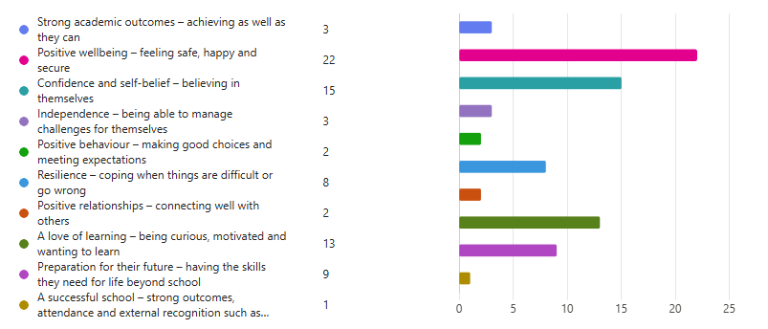
What do we want for the children in our schools?

Slide 7


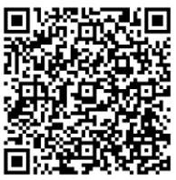
We don't start with a label.
We start with the child.

Slide 8


Slide 9
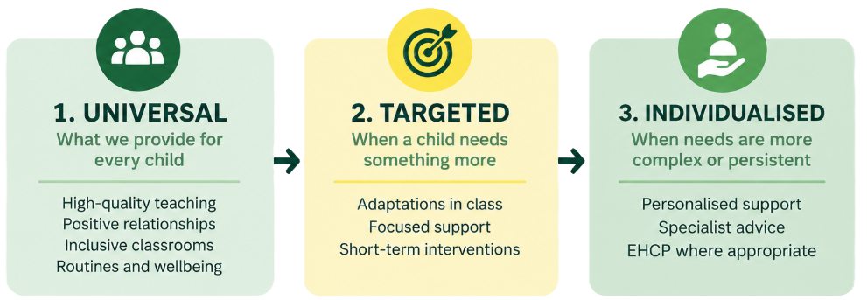

Slide 11











Overwhelmed
Rejected
Unsafe
Embarrassed
Angry
Being told off
Change or uncertainty
Being late
Roots & Fruits
Being left out
Getting something wrong
Notes:
Sometimes what we experience as difficult behaviour may be a child's attempt to manage something that feels difficult to them.
That doesn't make unsafe or harmful behaviour okay. Understanding what may be driving it gives us a better chance of helping the child learn a different response.
This sets up Roots & Fruits later.

Slide 12
Upcoming Events

Slide 13
Online Safety with The 2 Johns – 24th September
PUPILS
PARENTS & CARERS
Years 3–6
8:00–9:30pm
Age-appropriate online safety sessions during the school day.
Online parent session — join from home.
Helping children think critically, make safe choices, speak up and know where to go for help.
Practical advice on apps, online behaviour, boundaries and supporting children safely at home.
Please put the date in your diary — joining information will follow.
5

Slide 14
September
22nd - Welcome meeting/Bedtime stories 5-6pm. Parent/carer session with pupils
24th - JFAN Open evening for year 6 pupils to look round the school (contact JFAN for more details)
24th - 2 Johns Internet Safety sessions in school for KS2 Children. Parent Event 20:00-21:30pm (virtual)
29th - Phonics Cafe - 2.30pm with Mrs Harriss: parent/carer session for Oak Class and anyone else who is interested
October
1st - Themed lunch - Space day (order via School Grid)
7th - SEND Cafe - 9am with Mr Barnes parent/carer session
16th - Wimbish Walk, this years dressing up theme is animals
21st - Flu vaccinations (nasal spray)
22nd - Parents evening
26th - 30th - Half Term week
31st - Deadline for secondary school applications - current year 6 pupils
November
2nd - Inset Day- no pupils
11th - Remembrance Day- details to follow
12th - School photos (individual, class and sibling)
20th-Learning Together: Reading 2-3pm Mrs Butcher. Parent/carer session with pupils
27th - Inset Day-no pupils
December
11th - KS1 Production 2pm
21st Dec - 1st January, End of term break
5

Slide 15
Please collect your child/children from their classroom:
Infants in Oak
Y2/3 in Willow
Y4/5/6 in Birch
Thank you for coming

